Slide 1
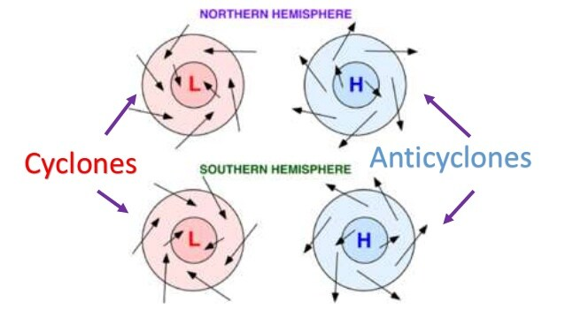
Recap: Cyclonic & anticyclonic wind directions
https://revision.co.zw/cyclones/

Slide 2
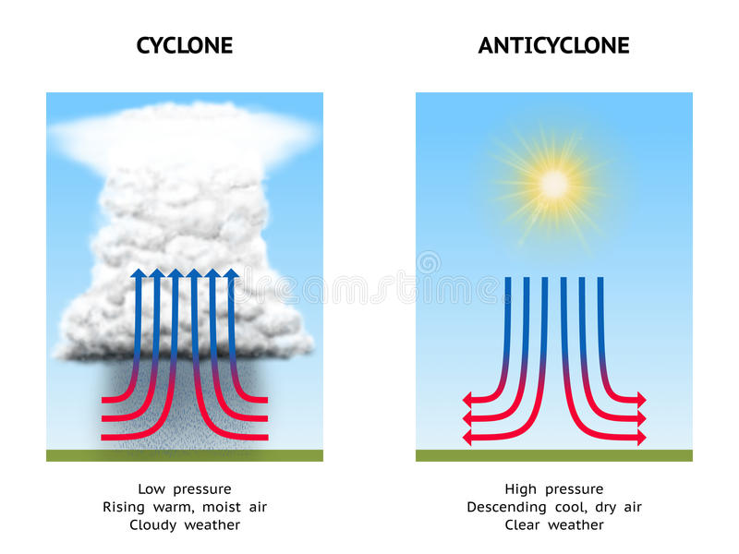
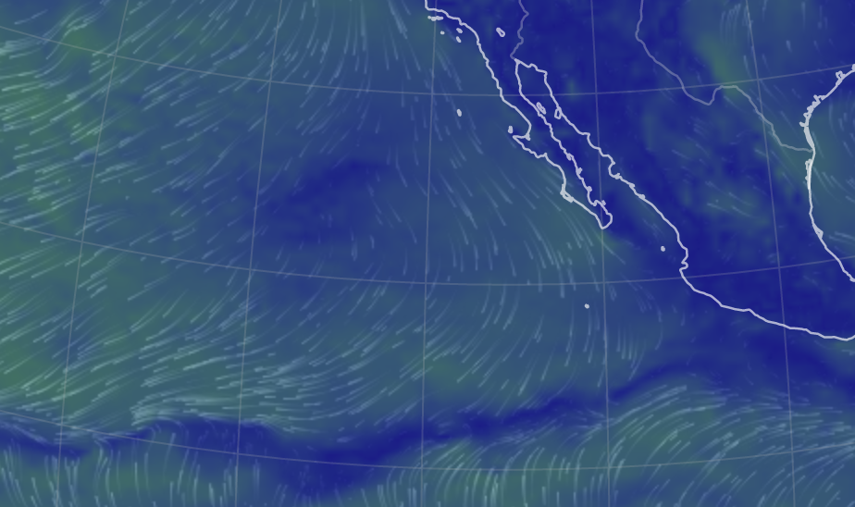
Recap: Cyclonic & anticyclonic wind directions

Slide 3
Recap: Cyclonic & anticyclonic wind directions

Slide 4
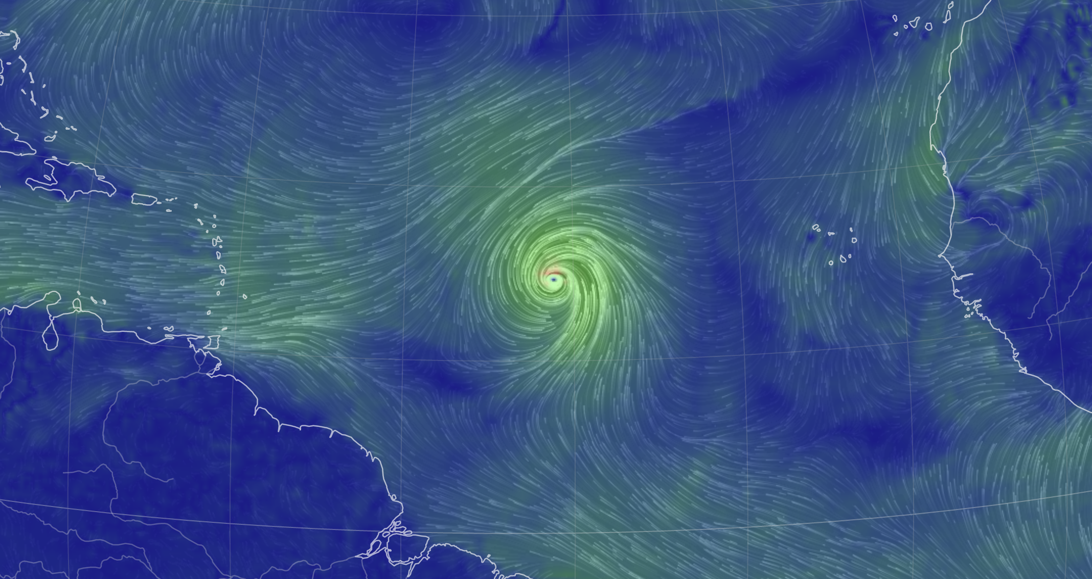
Recap: Cyclonic & anticyclonic wind directions

Slide 5
Recap: Cyclonic & anticyclonic wind directions

Slide 6
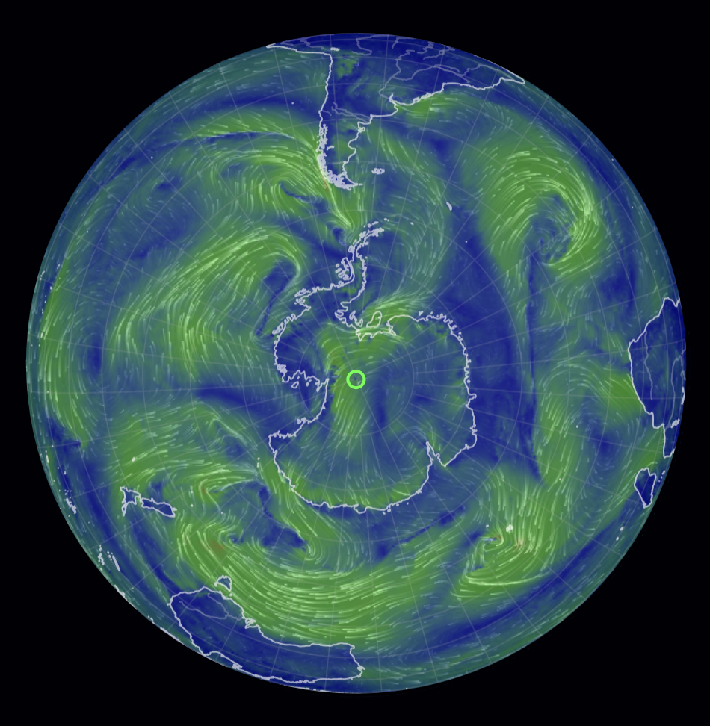
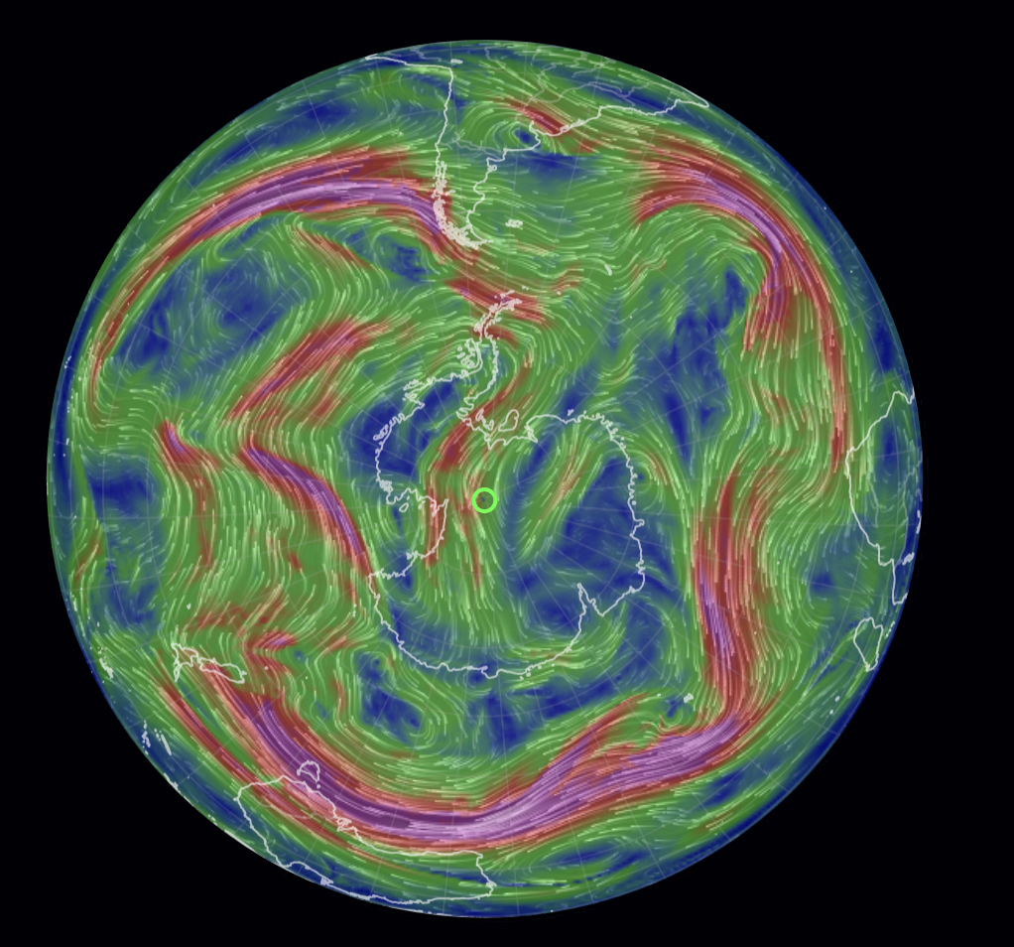
Recap: Jet stream
High altitude? Surface?

Slide 7
Recap: Jet stream
High altitude? Surface?
Surface
High altitude

Slide 8
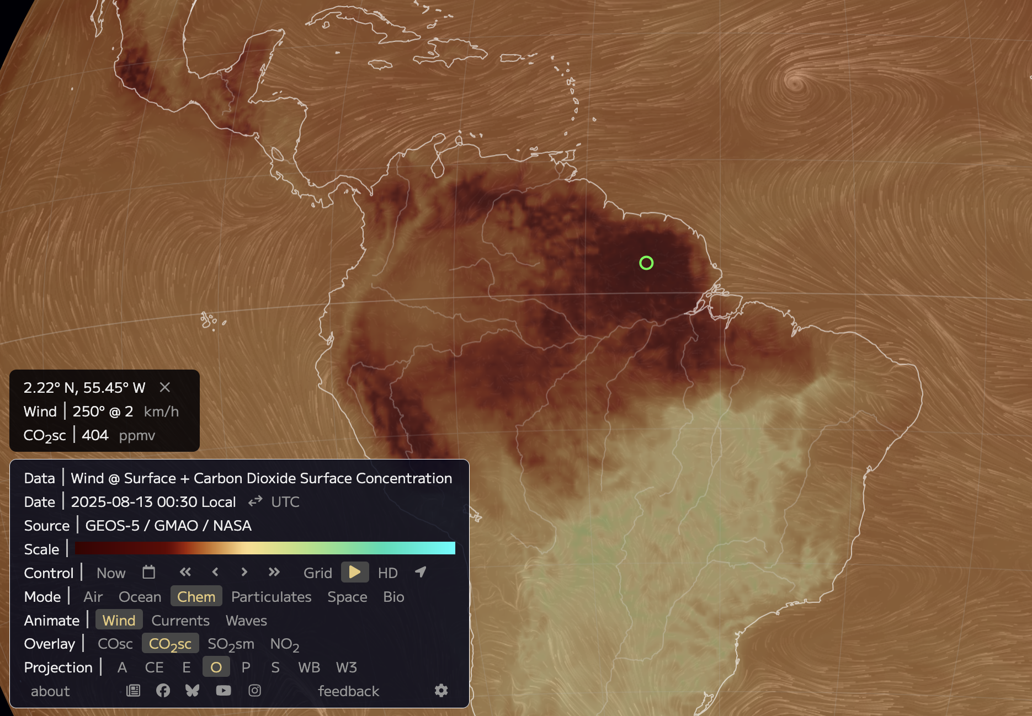
Recap: CO₂ and the calendar function
August 2025
CO₂ Source
CO₂ Sink

Slide 9
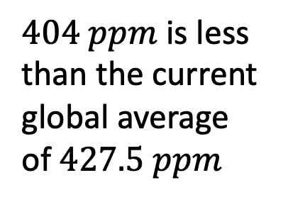
Recap: CO₂ and the calendar function
August 2025
CO₂ Source
CO₂ Sink
$404 ppm$ is less than the current global average of $427.5 ppm$

Slide 10
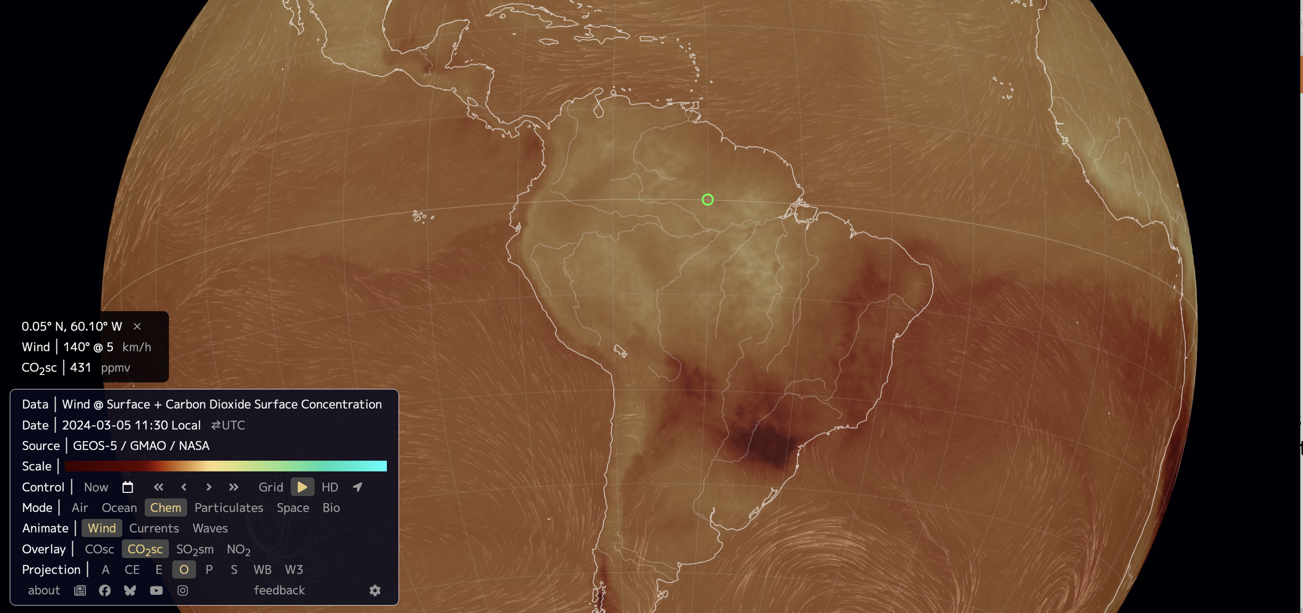
Recap: CO₂ and the calendar function
March 2024
CO₂ Source
CO₂ Sink

Slide 11
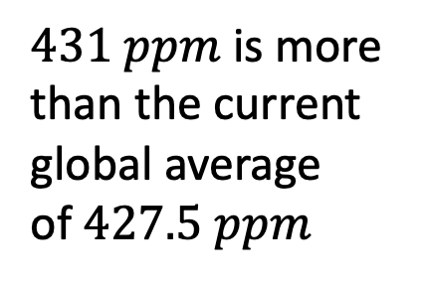
Recap: CO₂ and the calendar function
March 2024
CO₂ Source
CO₂ Sink
$431 ppm$ is more than the current global average of $427.5 ppm$

Slide 12
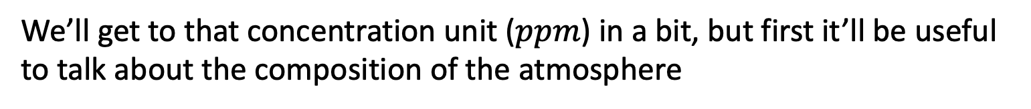
Recap: CO₂ and the calendar function
March 2024
CO₂ Source
CO₂ Sink
$431 ppm$ is more than the current global average of $427.5 ppm$
We’ll get to that concentration unit ($ppm$) in a bit, but first it’ll be useful to talk about the composition of the atmosphere

